Slide 1
Recap of work so far
Kinetic-molecular theory of gases
Why gases cool on expansion, heat up on compression
-> How much energy is in a sample of gas molecules? (Week 3)
Thermodynamic surfaces

Slide 2
Recap: Kinetic-molecular theory of gases
Normally, when a molecule hits a wall, it bounces back with the same speed.
Mental representation of a gas: molecules in constant motion

Slide 3
Recap: Kinetic-molecular theory of gases
Normally, when a molecules hits a wall, it bounces back with the same speed.
But when it hits a receding wall, it bounces back more slowly.
Slower-moving molecules correspond to lower temperature.
Mental representation of a gas: molecules in constant motion

Slide 4
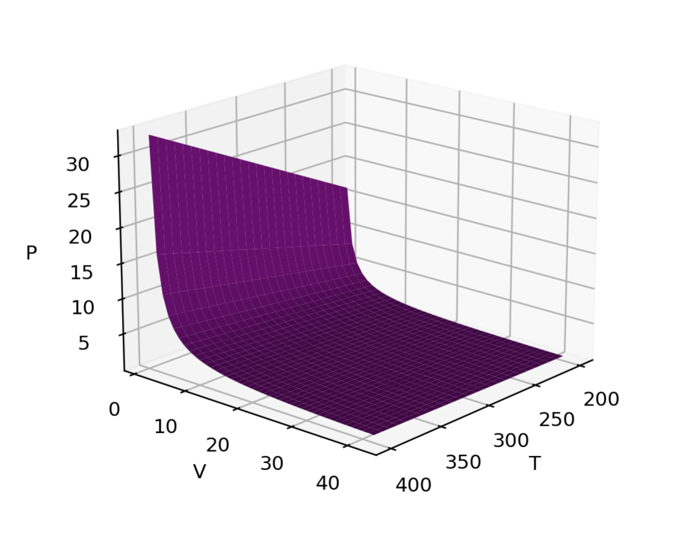
Recap: Thermodynamic surfaces
Here, the state function is the pressure of a gas.
The state space consists of the gas’s temperature and volume.
Each combination of temperature and pressure implies a particular value of the pressure:
P(T,V)
This one is an ideal gas, actually. So we can say
P(T,V)=nRT/V

Slide 5
Today
Ideal Gas Law
van der Waals (vdw) gas law
Entering numbers in scientific notation: the E-format
Units: using pint’s UnitRegistry (ureg)
Evaluating the difference between an ideal gas and a vdw gas

Slide 6
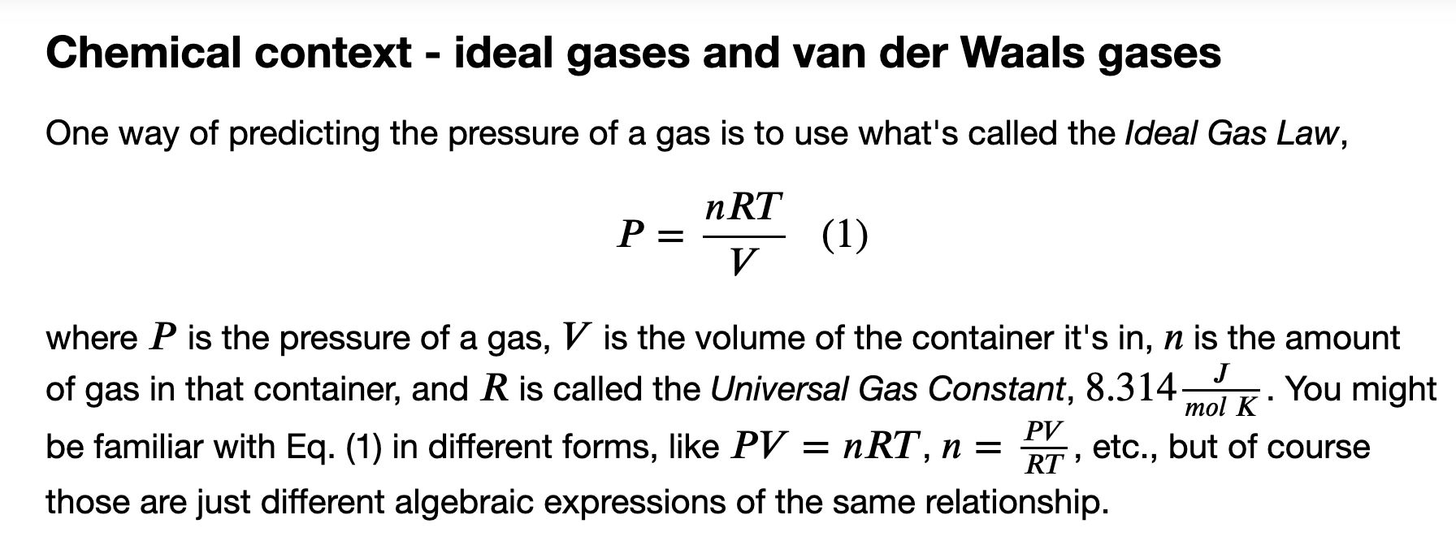
The Ideal Gas Law

Slide 7
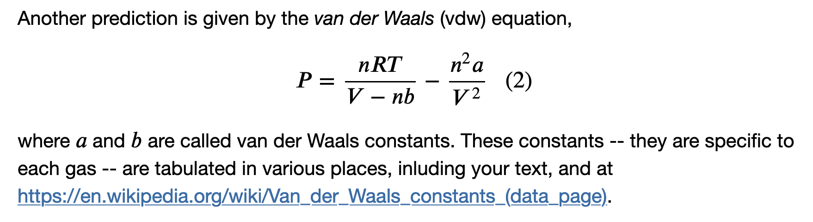
The van der Waals Gas Law
Since a and b are tuned to each gas, we expect vdw to be more accurate than the ideal gas law. You’ll be exploring how much more.
Spoiler: under ordinary room conditions, it works pretty well.

Slide 8
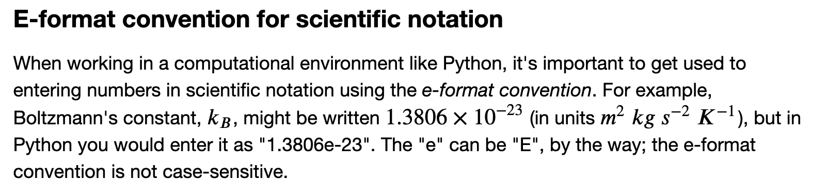
Scientific notation

Slide 9
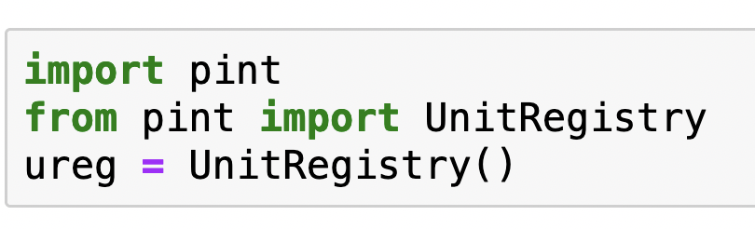
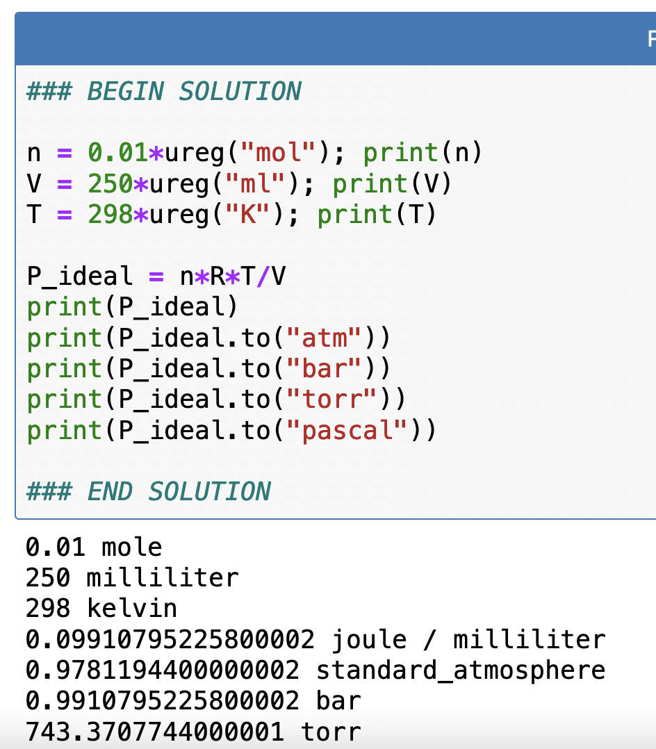
Units: using pint’s UnitRegistry (ureg)
This is how you bring pint & ureg into your Python notebook (“importing”)
Super-handy because pint does conversions for you. Say you want $P=nRT/V$

Slide 10
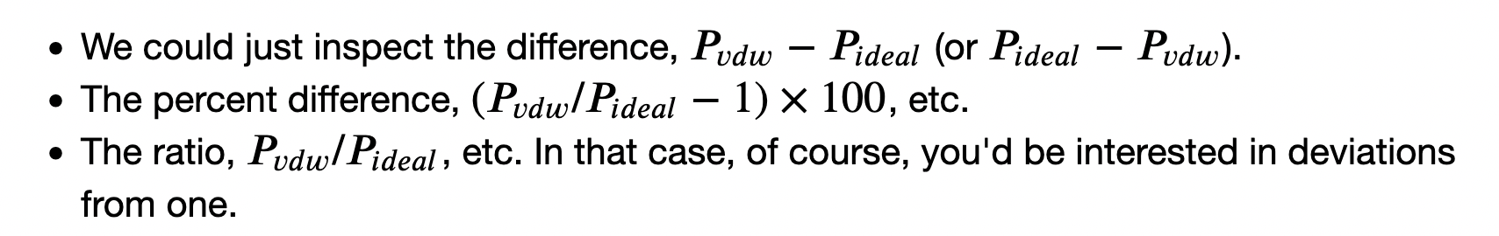
Evaluating the difference between an ideal gas and a vdw gas
Call this P_ideal in your Jupyter Notebook
Call this P_vdw in your Jupyter Notebook

